Slide 1
King Lear
By: William Shakespeare
08 April, 2013
Salar Qasim
Cihan University

Slide 2
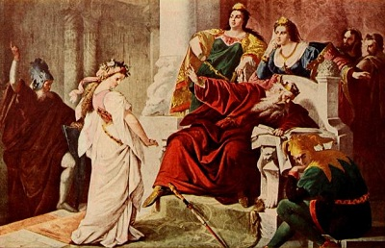
A King grown old but not wise

Slide 3
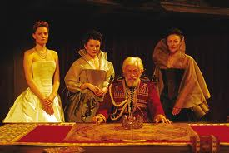
Introduction
Genre
Hamartia
Character map
Major themes
Parallel plots
Plot Summary
Conclusion
Discussion

Slide 4
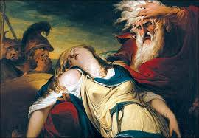
Genre
“King Lear” is classified as tragedy
To be tragedy two things are to be true:
  The main character must be someone who matters (important), like “King Lear’ himself.
  The tragic hero has to be put in a situation with the flaws in his character lead to demise

Slide 5
Hamartia
•As a tragedy, King Lear portrays a protagonist whose fortunes are conditioned by his hamartia. As defined by Aristotle, the protagonist of a tragedy should be a person “who is not eminently good or just, yet whose fortune is brought about by some error or frailty.” This error is not necessarily a flaw in character; hamartia can be an unwitting misstep in definite action or the failure to perform a definite action.
•Lear‘s hamartia is the capricious division of his powers and kingdom before his death—more particularly, the disavowal of Cordelia because she will speak “nothing”

Slide 6
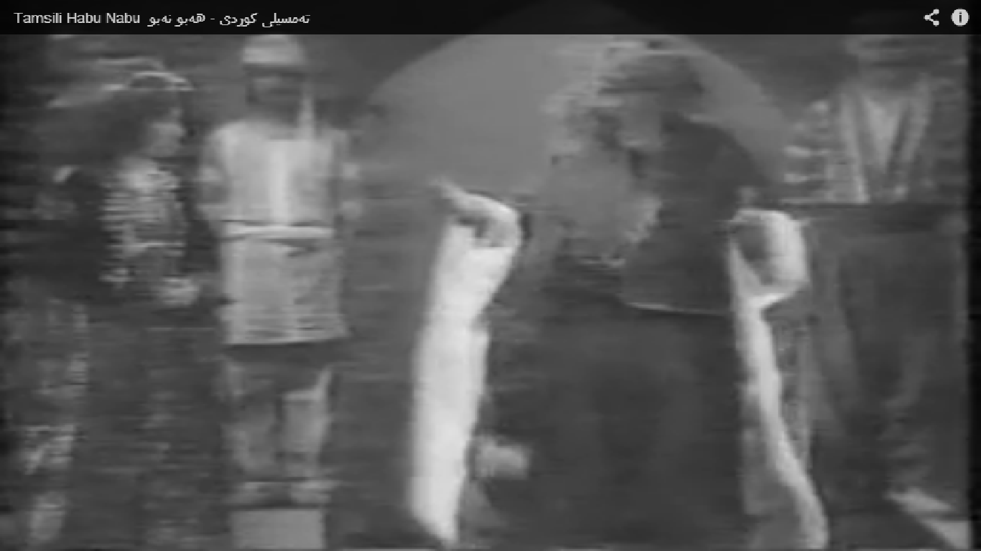
“tell me how much you love me”

Slide 7
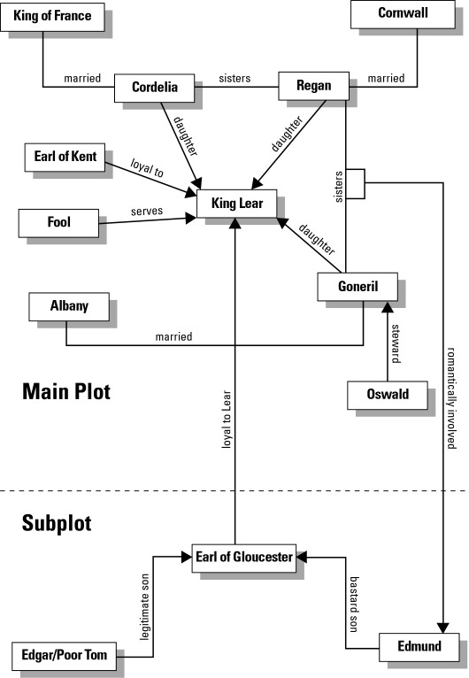
Character map

Slide 8
Themes, Motifs & Symbols
Themes
- Justice:King Lear is a brutal play, filled with human cruelty and awful, seemingly meaningless disasters.
- Authority versus Chaos: King Lear is about political authority as much as it is about family dynamics.
- Reconciliation: Cordelia remains devoted, even from afar, and eventually brings an army from a foreign country to rescue him from his tormentors.

Slide 9
Themes, Motifs & Symbols
Motifs
- Madness:Insanity occupies a central place in the play and is associated with both disorder and hidden wisdom
- Betrayal: King Lear is about political authority as much as it is about family dynamics.

Slide 10
Themes, Motifs & Symbols
Symbols
- The Storm:the storm echoes Lear’s inner turmoil and mounting madness
- Blindness:Gloucester’s physical blindness symbolizes the metaphorical blindness that grips both Gloucester and Lear.

Slide 11
Parallel Plots
Each family centers on an aging father (patriarch)
Lear: imperious tyrant
Gloucester: gullible
Each sees his children through a distorted lens, turning against the child who truly loves him, unleashing in the other children greed, lust, ambition.

Slide 12
Plot Summary
“King Lear” is about conflicts between fathers & their children.
Lear has three daughters (1 of them loves him & 2 of them no)
He gets angry at the good daughter, Cordelia & gives his kingdom to the 2 bad daughters, Goneril and Regan
Once they in charge of the kingdom, the bad daughters send him outside in a storm

Slide 13
Plot Summary
The other father is Glauster, one of Lear’s nobleman
He has 2 sons: Edmund and Edgar
Edmund, the younger one is a bastard
Edmund makes a plot to get rid of his brother and father to inherit Glauster’s money

Slide 14
Plot Summary
King Lear announces he is going to give up his kingdom among his daughters and divide it on his 3 daughters
He wants each of them to say how much they love him (who loves him most)
Goneril & Regan lie and say “they love Lear more that anything”
Cordelia, who actually does love him won’t do it – she says “she loves him as much as she should love her father, no more no less”

Slide 15
Plot Summary
Lear banishes Cordelia and tells he she is not his daughter any more
Goneril & Regan would divide his portion
Lear announces he is going to keep 100 knights as his followers
He spend his remaining days visiting Goneril & Regan
Kent tells Lear he’s acting crazy and he should change his mind
Lear tells him to “shut up” and dismisses him also from England – he will be dead if come back

Slide 16
Plot Summary
The King of France is visiting Lear and he takes Cordelia to be his queen
Edmund writes a fake letter that Edgar wants to kill his father, Glauster
Goneril & Regan dismiss Lear from their house even though it was night and storm
Cordelia’s follower catch Lear and he apologizes for his dicision
Cornwall, Regan’s husband is killed by 1 of his followers
Goneril & Regan are both in love with Edmund

Slide 17
Plot Summary
A battle between Albany, Goneril’s husband and the king of France, Cordelia’s husband breaks up
Cordelia’s forces lose and she is killed
Goneril & Regan and Edmund are all killed
Finally, the protagonist “Lear” is

Slide 18
Plot Summary
Finally, the protagonist “Lear” is also dead after he lost his mind again

Slide 19
Conclusion
Lear made a huge mistake by banishing his good daughter, Cordelia
He did not listen Kent, his Earl
Lear should not give up his power and divide his kingdom among his daughters before he dies
Once he was powerless, was damned by his 2 bad daughters
All the consequences were caused by the bad decision of Lear

Slide 20


Slide 21
Resources
www.sparknote.com
www.cliffnotes.com
www.enotes.com
www.shakerpeare-online.com
http://www.shmoop.com
www.google.com
www.youtube.com
http://www.gradesaver.com

